Slide 1

Machine Learning
Session 5 - T
Unsupervised Learning - Clustering
Ciência de Dados Aplicada
2023/2024

Slide 2
Unsupervised vs Supervised Learning
Unsupervised: involves working with unlabeled data, where the algorithm explores the inherent structure and patterns within the input without explicit output guidance.
Supervised: the algorithm is trained on a labeled dataset, where the input data is paired with corresponding output labels. The goal is to learn a mapping from inputs to outputs, allowing the algorithm to make predictions on new, unseen data.
Unsupervised Learning - Clustering
Session 5

Slide 3
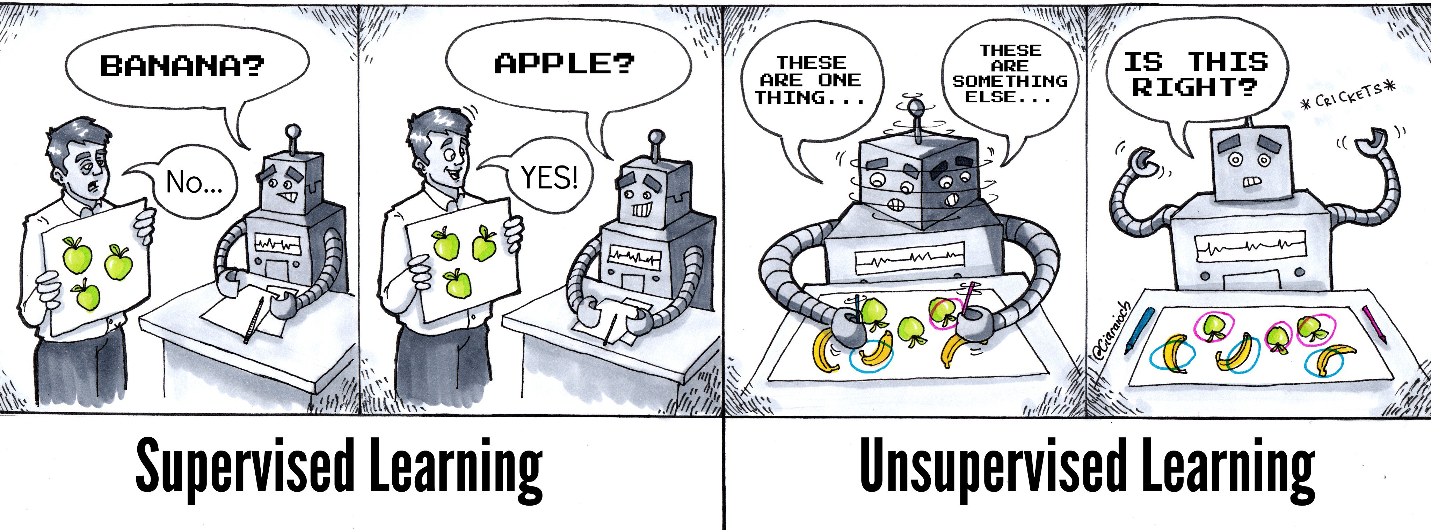
Unsupervised vs Supervised Learning
Illustration by @Ciaraioch
Unsupervised Learning - Clustering
Session 5

Slide 4
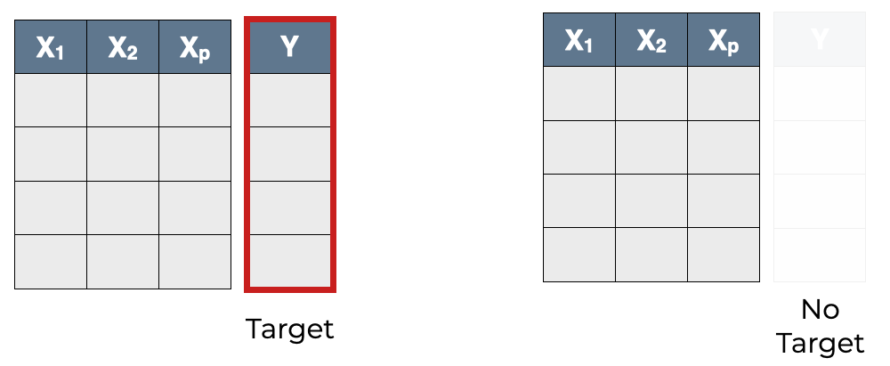
Unsupervised Learning
What can we do in the absence of target labels?
Group data based on similarity ⇒ clustering
Simplify/reduce data ⇒ dimensionality reduction
Visualize data ⇒ data visualization
Supervised
Unsupervised
Unsupervised Learning - Clustering
Session 5

Slide 5
Clustering
Clustering is not a well-defined term with varying definitions in the literature:
Finding groups in data;
Dividing data into homogeneous groups;
Dividing data into groups where points within each group are close or similar;
Dividing data into groups where points within each group are close or similar, and points of different groups are far or dissimilar;
Dividing the feature space into regions with relatively high density of points, separated by regions with relatively low density of points.
Unsupervised Learning - Clustering
Session 5

Slide 6
Our First Clustering Task
How many clusters?
Which forms belong to each cluster?
Unsupervised Learning - Clustering
Session 5

Slide 7
Our first clustering task
3 clusters
by shape
Unsupervised Learning - Clustering
Session 5

Slide 8
Our first clustering task
2 clusters by color
Unsupervised Learning - Clustering
Session 5

Slide 9
Clustering
Mathematically, clustering can be defined as a set of optimization problems with several variants.
The clustering thecnique to use depens on:
Data type (e.g. numeric, nominal);
Desired output format (e.g. exclusive clusters, probabilities, hierarchies);
Objective function (e.g. homogeneity vs separation);
Similarity/distance measure (e.g. euclidean, manhattan distance).
Unsupervised Learning - Clustering
Session 5

Slide 10
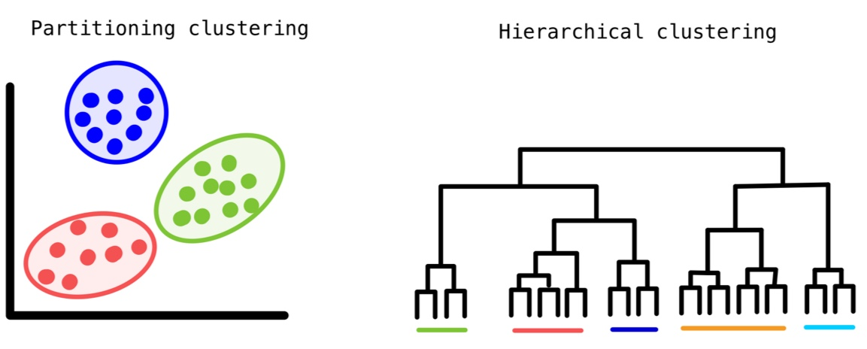
Defining Clusters
Partitional clustering:
Data is divided into groups at the same level.
Hierarchical clustering:
Clusters are nested within larger clusters, in a tree.
Unsupervised Learning - Clustering
Session 5

Slide 11
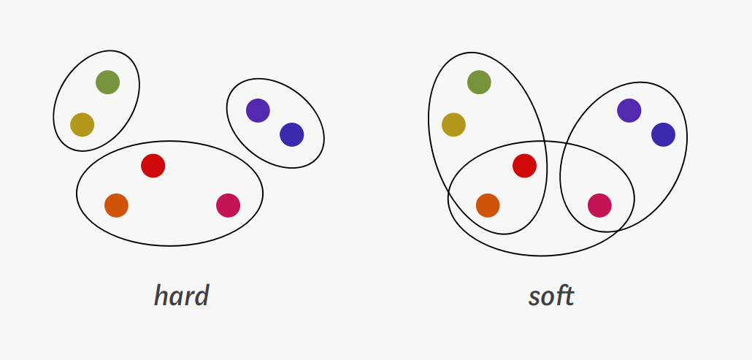
Clustering Membership
Hard clustering:
Each example belongs only to one cluster.
Soft clustering:
Examples may belong to more than one cluster.
Fuzzy clustering:
Each example belongs to clusters with probabilities.
Unsupervised Learning - Clustering
Session 5

Slide 12
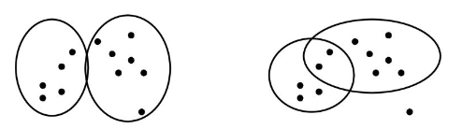
Clustering Coverage
Complete lustering:
All examples are assigned to cluster (or clusters);
Partial clustering:
Some examples unassigned (e.g. noise, irrelevant data)
Unsupervised Learning - Clustering
Session 5

Slide 13
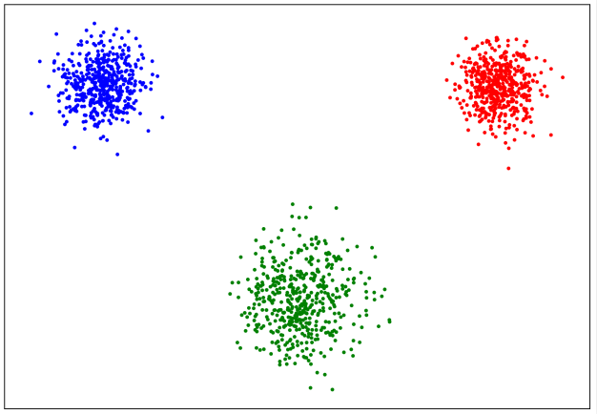
Types of Clustering
Well separated clusters:
Distance between any two points in different clusters is larger than the distance between any two points in the same group.
Unsupervised Learning - Clustering
Session 5

Slide 14
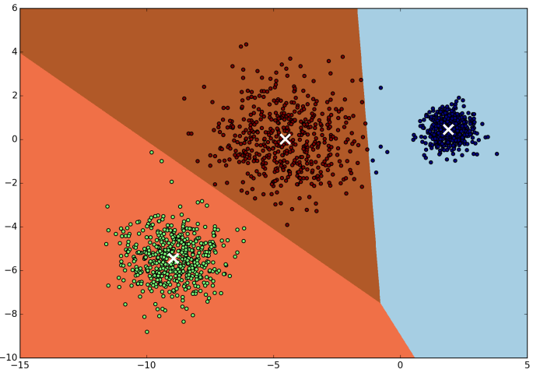
Types of Clustering
Prototype-based clustering:
Examples in a cluster are closer to the prototype of the cluster than to the prototype of any other cluster.
If the data is numerical, the prototype of the cluster is often a centroid i.e., the average of all the points in the cluster.
If the data has categorical attributes, the prototype of the cluster is often a mode i.e., the most representative point of the cluster.
Unsupervised Learning - Clustering
Session 5

Slide 15
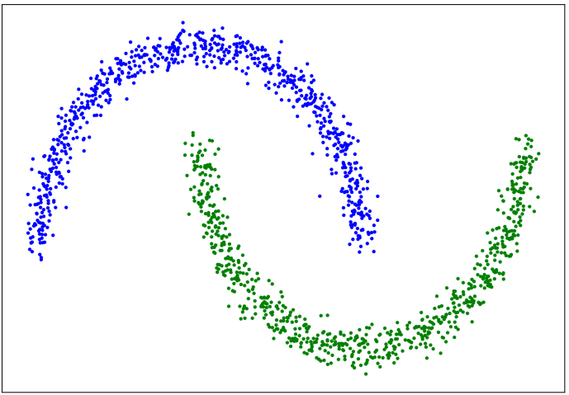
Types of Clustering
Contiguity-based clustering:
Each example in a cluster is closer to at least one example in the same cluster than to any example in a different cluster.
Useful when clusters are irregular and intertwined.
Does not work well when there is noise in the data.
Unsupervised Learning - Clustering
Session 5

Slide 16
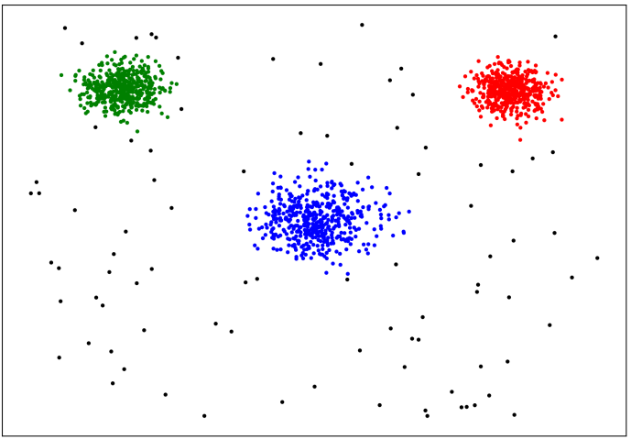
Types of Clustering
Density-based clustering:
Cluster is a dense region of examples that is surrounded by a region of low density.
Used when the clusters are irregular, intertwined and when noise and outliers are present.
Examples in low density region are classified as noise and omitted.
Unsupervised Learning - Clustering
Session 5

Slide 17
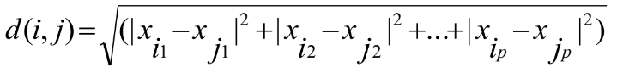
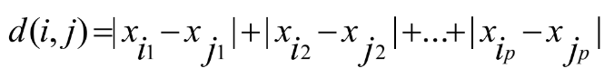
Similarity
Sometimes is difficult to determine what is similar or not!
Distance measures:
Euclidean distance:
Manhattan distance:
Unsupervised Learning - Clustering
Session 5

Slide 18
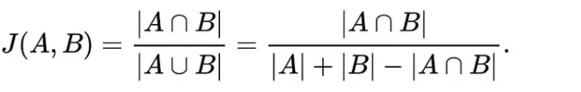
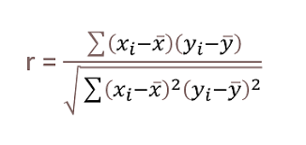
Similarity
Sometimes is difficult to determine what is similar or not!
Similarity measures:
Jaccard similarity:
Pearson correlation:
Unsupervised Learning - Clustering
Session 5

Slide 19
Homogeneity and Separation
Homogeneity: elements within a cluster must be close to each other (low distances) – intra-cluster
Separation: elements in different clusters should be quite separate from each other (high distances) - inter-cluster
Unsupervised Learning - Clustering
Session 5

Slide 20
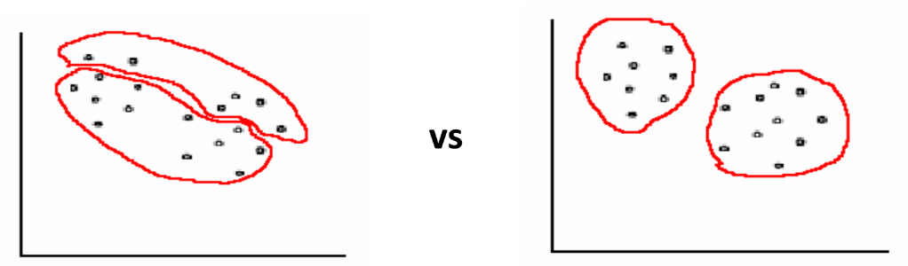
Which clustering would you choose (and why)?
Unsupervised Learning - Clustering
Session 5

Slide 21
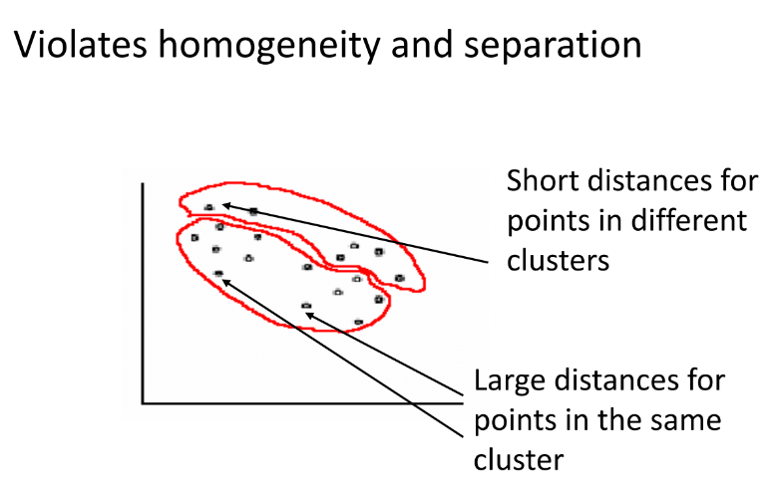
Clustering: "bad" solution
Unsupervised Learning - Clustering
Session 5

Slide 22
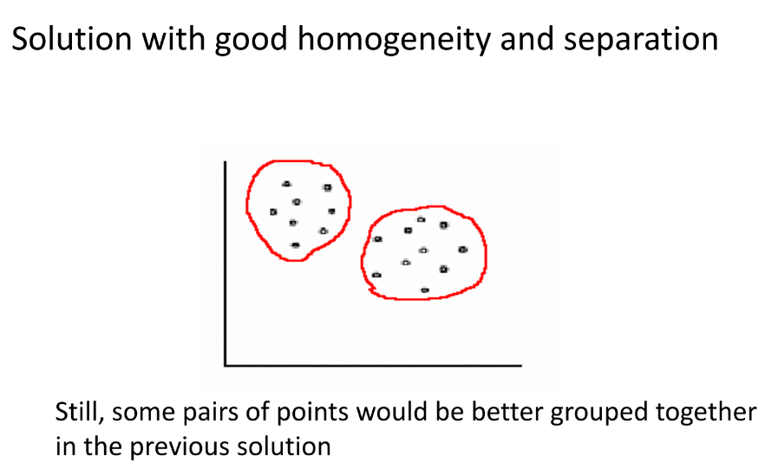
Clustering: "good" solution
Unsupervised Learning - Clustering
Session 5

Slide 23
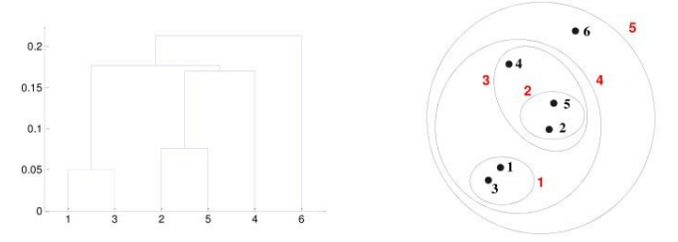
Hierarchical Clustering
Generates a set of nested clusters organized as a hierarchical tree;
Visual representation often depicted as a dendrogram:
A tree like diagram representing a hierarchy of nested clusters
Clustering obtained by cutting at desired level
Unsupervised Learning - Clustering
Session 5

Slide 24
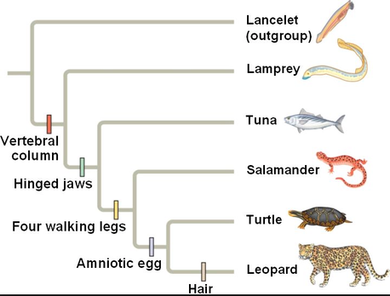
Hierarchical Clustering - Advantages
Do not have to assume any particular number of clusters;
May correspond to meaningful taxonomies.
Unsupervised Learning - Clustering
Session 5

Slide 25
Hierarchical Clustering Types
Agglomerative:
Start with the examples as individual clusters;
At each step, merge the closest pair of clusters until only one cluster (or k clusters) left.
Divisive:
Start with one cluster with all examples;
At each step, split a cluster until each cluster contains a example (or there are k clusters).
Unsupervised Learning - Clustering
Session 5

Slide 26
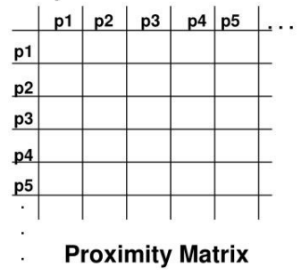
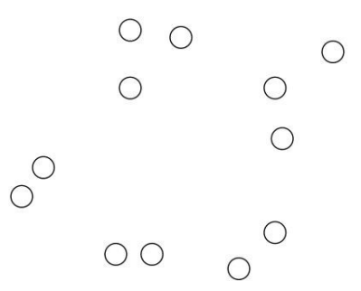
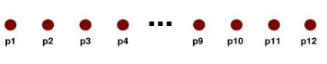
Agglomerative Hierarchical Clustering
Compute the proximity matrix;
Let each example be a cluster;
Merge the two closest clusters;
Update the proximity matrix;
Repeat 3 and 4 until a single
cluster remains (or k clusters).
Unsupervised Learning - Clustering
Session 5

Slide 27
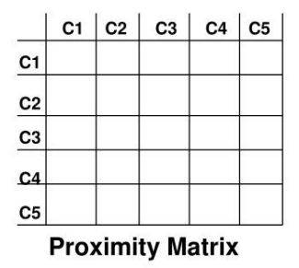
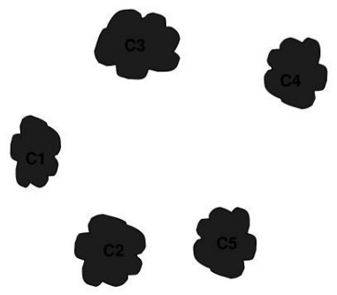
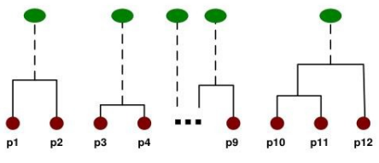
Agglomerative Hierarchical Clustering
Compute the proximity matrix;
Let each example be a cluster;
Merge the two closest clusters;
Update the proximity matrix;
Repeat 3 and 4 until a single
cluster remains (or k clusters).
Unsupervised Learning - Clustering
Session 5

Slide 28
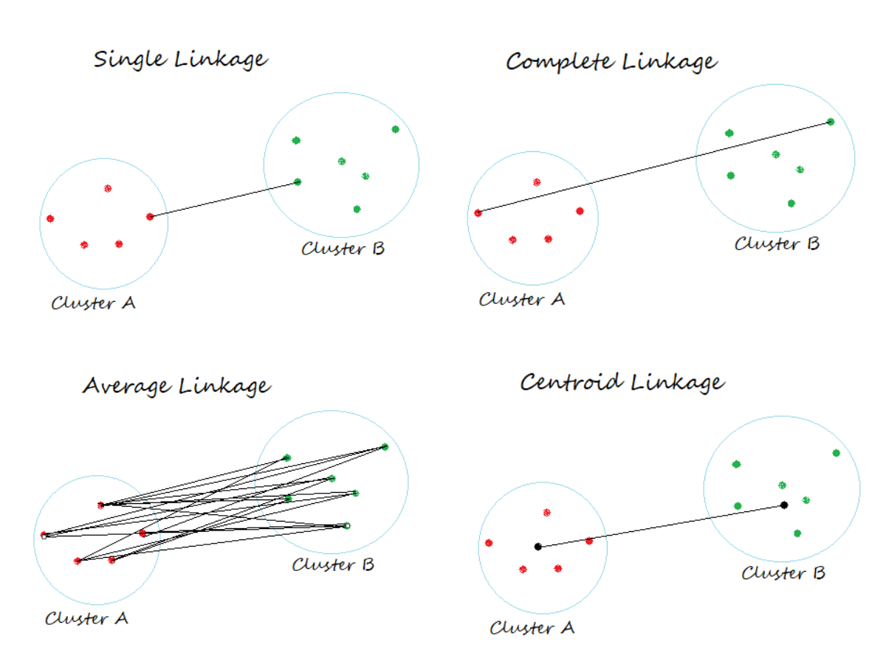
Hierarchical Clustering – Cluster Similarity
Unsupervised Learning - Clustering
Session 5

Slide 29
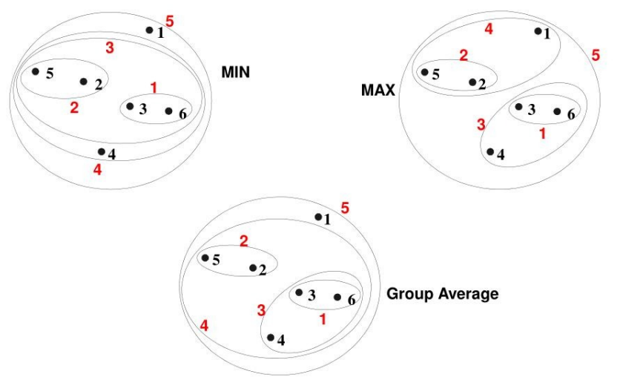
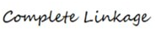
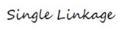
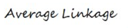
Hierarchical Clustering – Single vs Complete vs Average
Unsupervised Learning - Clustering
Session 5

Slide 30
Hierarchical Clustering – Single vs Complete vs Average
Single Linkage:
Can handle non-eliptical shapes;
Sensitive to noise and outliers.
Complete Linkage:
Less susceptible to noise and outliers;
Tends to break large clusters;
Biased towards globular clusters.
Average Linkage:
Compromise between single and complete linkage;
Less susceptible to noise and outliers;
Biased towards globular clusters.
Unsupervised Learning - Clustering
Session 5

Slide 31
Hierarchical Clustering – Limitations
Do not scale well:
Space complexity: O(N²)
Time complexity: O(N³)
O(N² log(N)) for some approaches.
Cannot undo what was previosly done;
Quality varies a lot in terms of distance measure used.
Unsupervised Learning - Clustering
Session 5

Slide 32
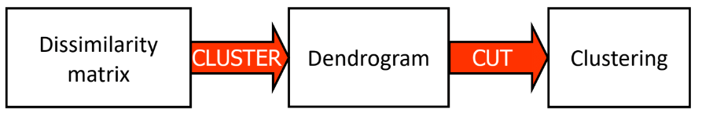
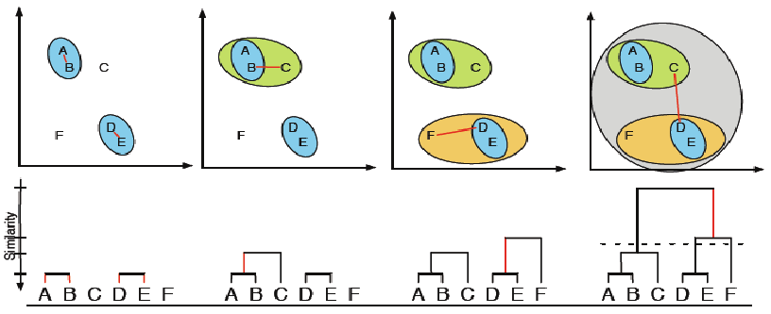
Hierarchical Clustering - Summary
Unsupervised Learning - Clustering
Session 5

Slide 33
Hierarchical Clustering – Applications
Biology: Used in genomics for grouping genes with similar expression patterns, clustering protein sequences, and phylogenetic analysis.
Marketing: Segmentation of customers based on purchasing behavior or demographic characteristics to tailor marketing strategies.
Image Analysis: Grouping similar images together for tasks such as image retrieval, object recognition, and image compression.
Document Clustering: Organizing documents by topic for information retrieval, text mining, and document summarization.
Anomaly Detection: Identifying outliers or unusual patterns in data, such as detecting fraudulent transactions or network intrusions.
Finance: Segmenting financial data for portfolio optimization, risk assessment, and fraud detection.
Unsupervised Learning - Clustering
Session 5

Slide 34

K-Means Clustering
Find best clustering of k clusters
Partitional, exclusive, complete and prototype-based;
Define clusters by proximity to the mean of the cluster (centroid);
The number of clusters is predefined (k).
Objective: find the centroids that minimize the distance between the examples and the centroids.
Unsupervised Learning - Clustering
Session 5

Slide 35
K-Means Clustering: Lloyd Algorithm
Because the optimal solution for this problem is NP-hard, practical useful solutions can be obtained with simple heuristic algorithms such as the Lloyd algorithm.
Lloyd algorithm:
Start with random centroids;
Assign each example to the closest centroid;
Update centroids to mean of respective cluster;
Recompute clusters and repeat until convergence.
Does not guarantee optimal solutions as in practical implementations a maximum number of iterations is commonly defined.
Unsupervised Learning - Clustering
Session 5

Slide 36
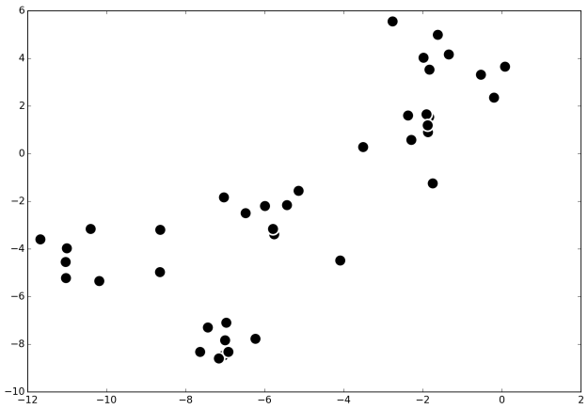
K-Means Clustering: Initialization
Forgy: start with coordinates of a random set of k examples
Unsupervised Learning - Clustering
Session 5

Slide 37
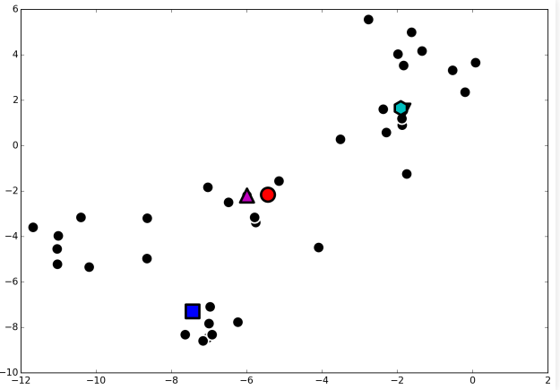
K-Means Clustering: Initialization
Forgy: start with coordinates of a random set of k examples
Unsupervised Learning - Clustering
Session 5

Slide 38
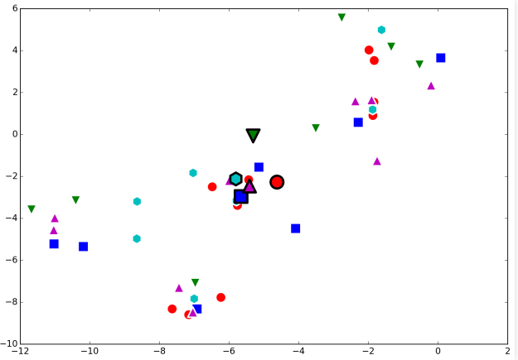
K-Means Clustering: Initialization
Random: random assignment, compute means
Unsupervised Learning - Clustering
Session 5

Slide 39
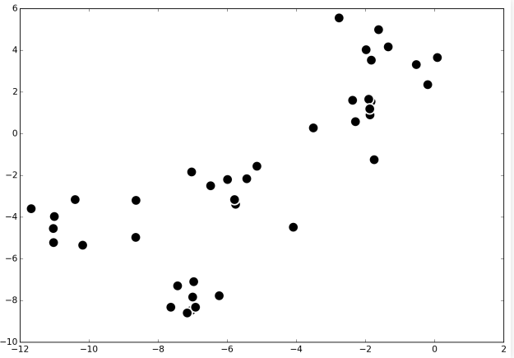
K-Means Clustering: Lloyd Algorithm
Original data
Unsupervised Learning - Clustering
Session 5

Slide 40
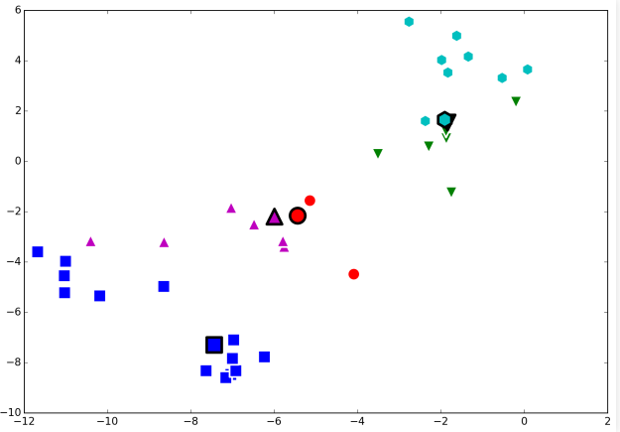
K-Means Clustering: Lloyd Algorithm
Initialize (Forgy), compute clusters
Unsupervised Learning - Clustering
Session 5

Slide 41
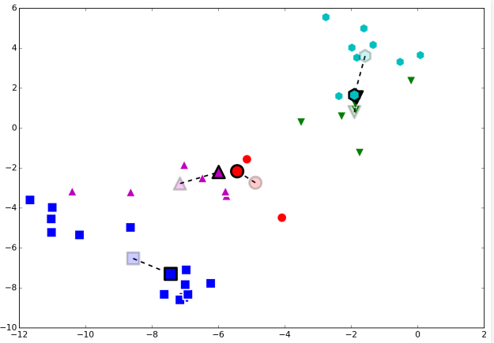
K-Means Clustering: Lloyd Algorithm
Compute new means, update centroids
Unsupervised Learning - Clustering
Session 5

Slide 42
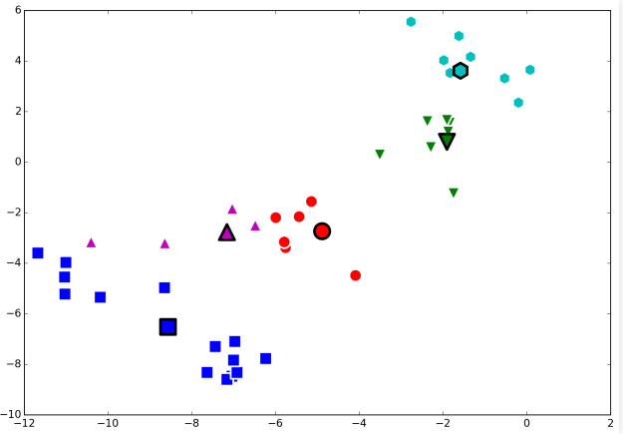
K-Means Clustering: Lloyd Algorithm
Recompute clusters
Unsupervised Learning - Clustering
Session 5

Slide 43
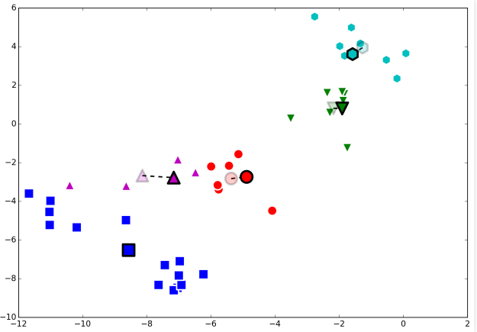
K-Means Clustering: Lloyd Algorithm
Compute new means, update centroids
Unsupervised Learning - Clustering
Session 5

Slide 44
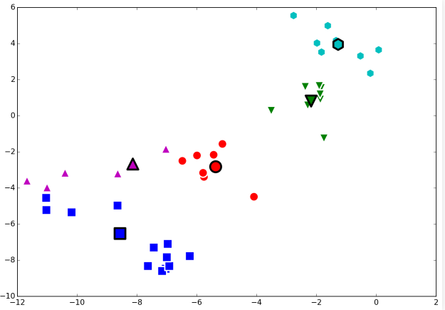
K-Means Clustering: Lloyd Algorithm
Recompute clusters
Unsupervised Learning - Clustering
Session 5

Slide 45
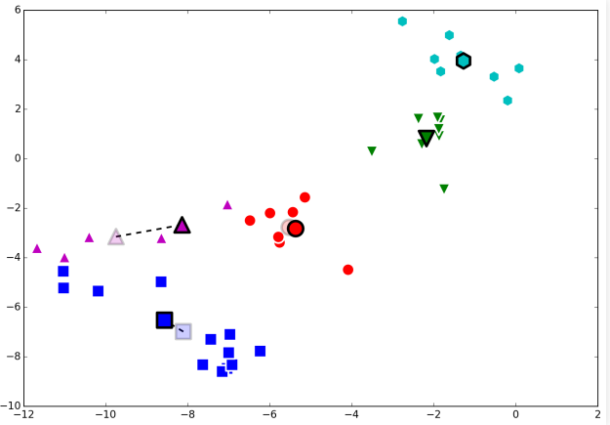
K-Means Clustering: Lloyd Algorithm
Compute new means, update centroids
Unsupervised Learning - Clustering
Session 5

Slide 46
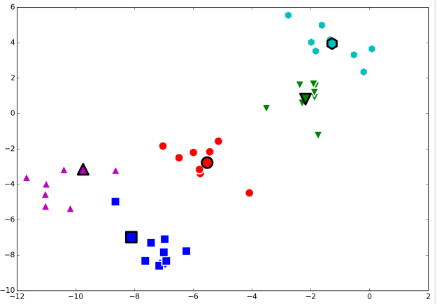
K-Means Clustering: Lloyd Algorithm
Recompute clusters
Unsupervised Learning - Clustering
Session 5

Slide 47
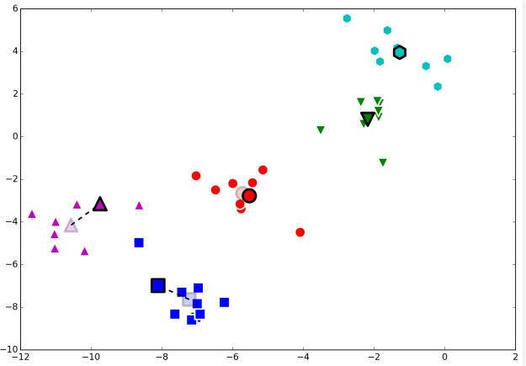
K-Means Clustering: Lloyd Algorithm
Compute new means, update centroids
Unsupervised Learning - Clustering
Session 5

Slide 48
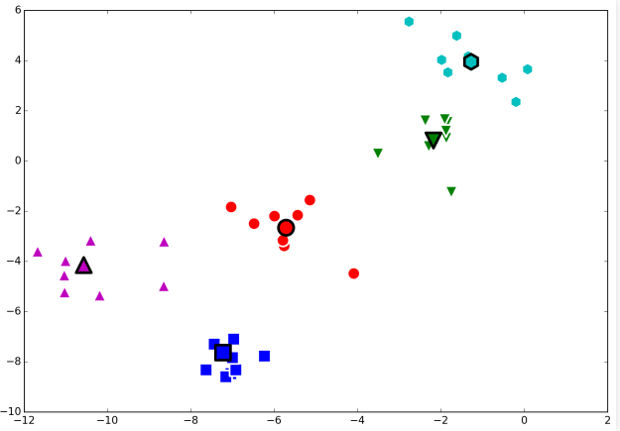
K-Means Clustering: Lloyd Algorithm
Recompute clusters
Unsupervised Learning - Clustering
Session 5

Slide 49

K-Means Clustering: Lloyd Algorithm
Compute new means, update centroids
Unsupervised Learning - Clustering
Session 5

Slide 50
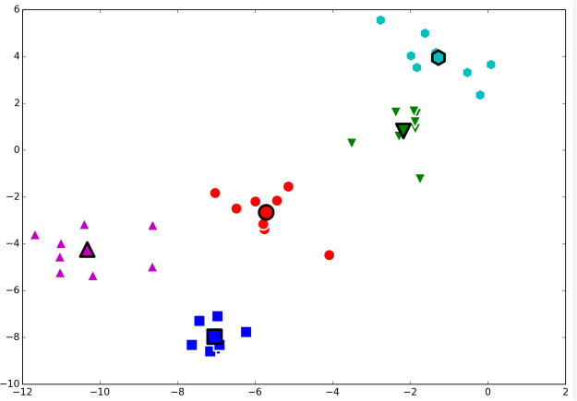
K-Means Clustering: Lloyd Algorithm
Until convergence
Unsupervised Learning - Clustering
Session 5

Slide 51
K-Means Clustering: Strengths and Limitations
Strenghts:
Simple and works well for disjoint clusters;
Relatively efficient and scalable (Lloyd algorithm);
Limitations:
k needs do be defined in advance;
Higly dependent on the initialization;
Unable to handle well noisy data and outliers;
Not suitable for clusters of different sizes and non-convex shapes.
Unsupervised Learning - Clustering
Session 5

Slide 52
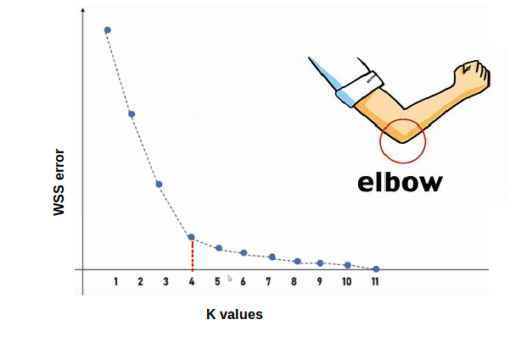
K-Means Clustering: Choosing k
Chosing the value of k is not a trivial task that heavily affects the outcome of the algorithm.
Elbow method: determine the optimal k
Iteratively applies K-means clustering with an increasing number of clusters.
Calculates the within-cluster sum of squares (WCSS)
for each iteration.
WCSS measures the compactness of clusters;
lower WCSS indicates better clustering.
Unsupervised Learning - Clustering
Session 5

Slide 53
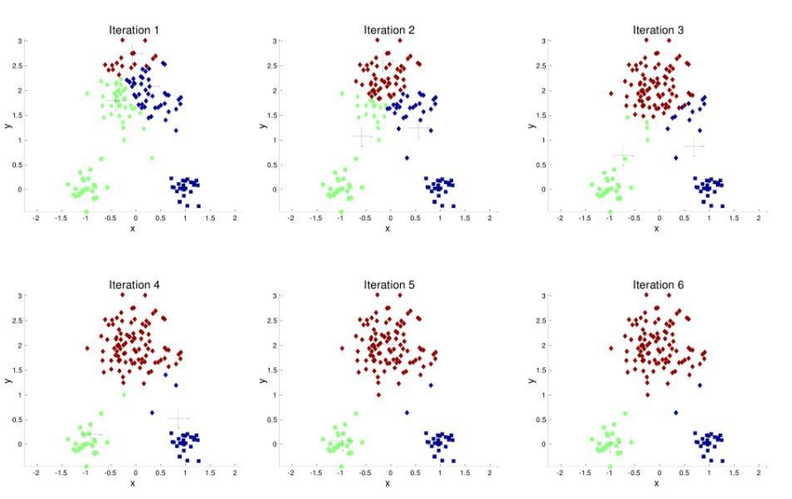
K-Means Clustering: Initialization
Importance of initialization: case 1
Unsupervised Learning - Clustering
Session 5

Slide 54
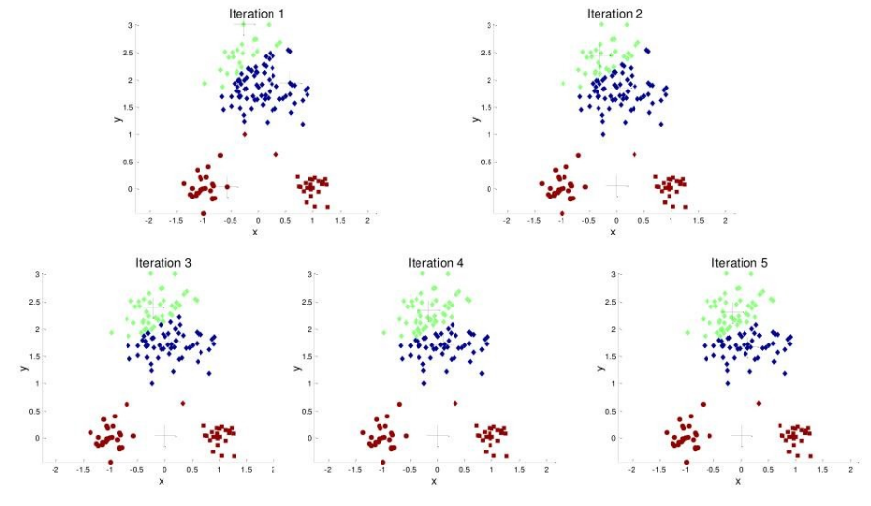
K-Means Clustering: Initialization
Importance of initialization: case 2
Unsupervised Learning - Clustering
Session 5

Slide 55
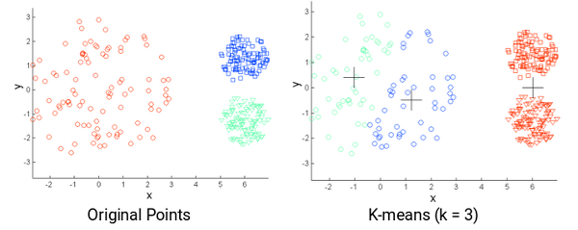
K-Means Clustering: Different Sizes
Unsupervised Learning - Clustering
Session 5

Slide 56
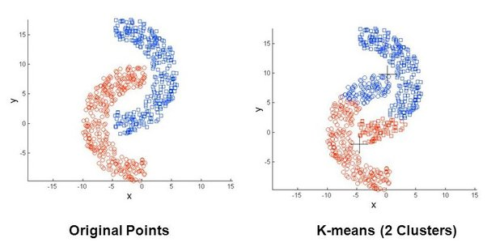
K-Means Clustering: Non-Convex Shapes
Unsupervised Learning - Clustering
Session 5

Slide 57
K-Means Variants
K-Medoids: prototypes are data points (medoids);
K-Modes: for categorical data. Utilizes mode-based distance measures (e.g., Hamming distance)
Unsupervised Learning - Clustering
Session 5

Slide 58
K-Means - Applications
Customer Segmentation: Identifying groups of customers with similar traits for targeted marketing and personalized services.
Image Compression: Simplifying images by reducing the number of colors, preserving visual quality while saving storage space.
Anomaly Detection: Spotting outliers in datasets, useful for fraud detection and quality control.
Document Clustering: Organizing documents by content similarity for efficient retrieval and topic modeling.
Retail Inventory Management: Optimizing inventory levels and product placement based on sales patterns.
Healthcare Data Mining: Grouping patients with similar medical profiles for diagnosis and treatment planning.
Climate Pattern Analysis: Identifying weather patterns and trends in climate data for forecasting and resource management.
Unsupervised Learning - Clustering
Session 5

Slide 59

Other Clustering Algorithms
https://scikit-learn.org/stable/modules/clustering.html
Unsupervised Learning - Clustering
Session 5

Slide 60
Resources
Berry, M. W., Mohamed, A., & Yap, B. W. (2019). Supervised and unsupervised learning for Data Science. Cham, Switzerland: Springer Nature.
Patel, A. A. (2019). Hands-on unsupervised learning using python. Sebastopol, CA: O’Reilly Media.
Unsupervised Learning - Clustering
Session 5

